Slide 1





GSU Honors Program
Welcome
Transfer Counselor Luncheon 2023
Craig Berry
Associate Director of Admissions
cberry@govst.edu

Slide 2
GSU Honors Program
Welcome Remarks & Enrollment Information
Welcome
Transfer Counselor Luncheon 2023
Craig Berry
Associate Director of Admissions
cberry@govst.edu
Paul McGuinness
Vice President of Student Affairs and Enrollment Management

Slide 3

Today’s Agenda
Introduction of the GSU Admissions Team and Guests
Admission Updates
Incumbent Workforce
Community Health
Dual Degree Program
Retention Incentives
Program Updates
Questions and Answers

Slide 4

Fall 2022 Enrollment

Slide 5


Fall 2022 Enrollment
Governors State University,
Institutional Research and Effectiveness
Key Figures Fall 2022
Total student FTE up 3.25%
Total student credit hours up 2.51%

Slide 6
Fall 2022 Enrollment
The public universities in Illinois had a post pandemic rebound with freshman and international graduate enrollment for the Fall 2022 semester.
The National Student Clearinghouse Research Center found that transfer enrollment had declined twice as much as non-transfer enrollment during the pandemic. This resulted in a 13.5% decrease in transfer enrollment since the beginning of the pandemic.
GSU new transfer enrollment for Fall 2022 is up 4% in headcount.

Slide 7
Fall 2022 Enrollment
Total number of student enrollment is 4,427 and credit hours generated is 43,008.

Slide 8


Fall 2022 Enrollment

Slide 9
New Student Enrollment

Slide 10

New Student
Fall 2022 Enrollment
New student enrollment not only returned to pre-pandemic levels but exceeded the largest new student class (2019). New student enrollment increased by 20%.

Slide 11
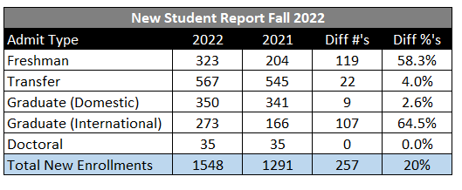

Fall 2022 New Student Enrollment
New student enrollment was positive in all categories - freshman, transfer, and graduate. The largest new student enrollment growth came from freshman with an increase of 58.3% (N=119) and international graduate with an increase of 64.5%(N=107).

Slide 12
Admissions Trends

Slide 13
Admissions Trends
Freshman
New freshman admissions pool had continuous growth until COVID. Fall 2022 was the first year of the Common App which resulted in a large jump in admitted students.

Slide 14
Admissions Trends
Transfer Students
National and Illinois transfer enrollment has been declining due to the drop in birthrates and the pandemic. GSU has increased transfer admissions by 30%. This stopped a four-year decline in transfer admissions.

Slide 15
Admissions Trends
Domestic Graduate Students
GSU continues to see an increase in domestic graduate students who are interested in
pursuing a masters degree.

Slide 16
Admissions Trends
International Students
With the change in US Presidential administration’s policy on foreign students and COVID travel restrictions being lifted, Fall 2021 and Fall 2022 had an exponential increase in international admissions.

Slide 17


Thank you

Slide 18
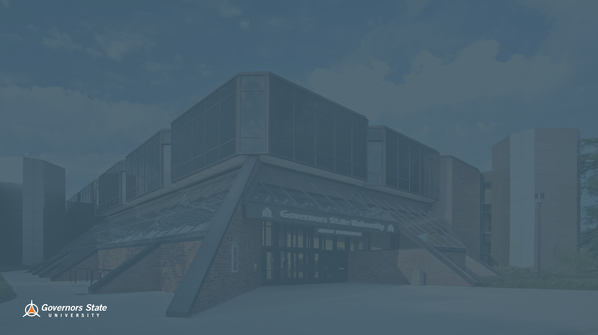
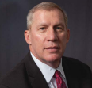
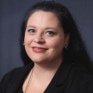
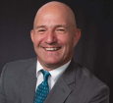


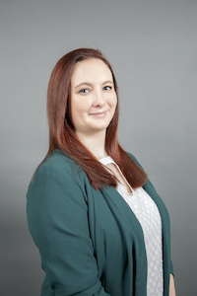
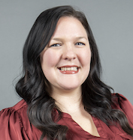
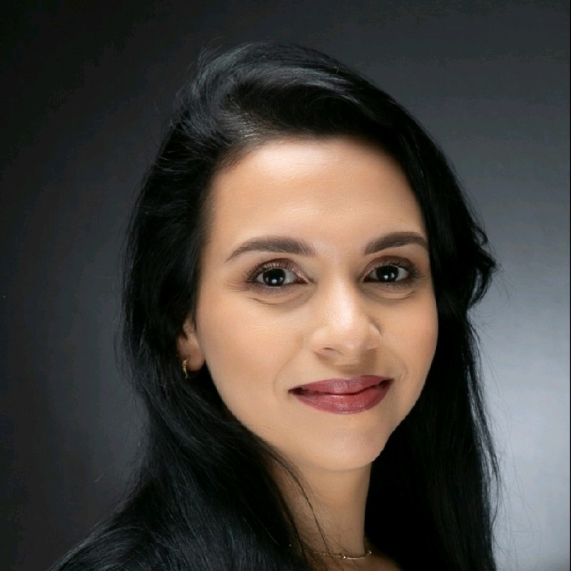
Meet our Admissions Team
Paul McGuinness Vice President for Student Affairs and Enrollment Management
pmcguinness@govst.edu
708.235.7308
Lise Schneider Executive Director of Admissions lschneider@govst.edu
708.534.7059
Craig Berry Associate Director of Admissions
cberry@govst.edu
708.235.2809
Emmanuel Lopez
Assistant Director of Transfer Admissions
Elopez6@govst.edu
708.263.7983
Tomice O'Brien​
Coordinator of Admissions​ Event and Communication​
Tobrien2@govst.edu ​
708.23/5.7170
Bailie Antwiler
Admissions Counselor
Bantwiler@govst.edu 7
08.235.6841
Noelle Larsen
Recruiting Specialist
Nlarsen@govst.edu
708.534.7891
Melinda Arce-Gudino
Admissions Counselor
Marce-gudino@govst.edu
708.235.7504

Slide 19

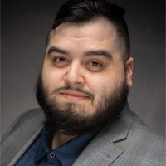
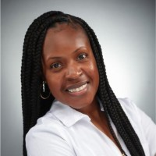

Meet our Dual Degree Program Team
Jessica Specht
Director, DDP Program
Jspecht@govst.edu
708.534.4494
Alexandro Venegas
Transfer Specialist
Avenegas2@govst.edu
708.235.7455
Sharita Walker
Transfer Specialist
Swalker3@govst.edu
708.235.7536
Juan Gonzalez
Transfer Specialist
Jgonzalez11@govst.edu
708.234.7534

Slide 20
Admission Updates
Lise’ Schneider
Executive Director of Admissions

Slide 21
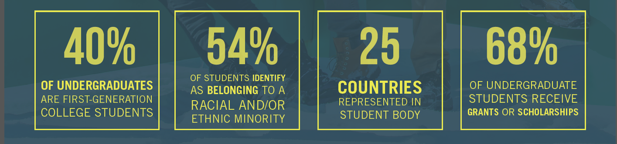
New 2 GSU
Latinx Center and First Gen Center- launching in 2023!
Jaguar Transfer Credit Evaluator
Common App for Transfer- No application fee
Athletics
  Varsity Reserve (Basketball & Soccer)
  New for Fall 2023- Women’s Bowling and Track

Slide 22
Transfer Application Requirements
General Admission Requirements
  No application fee
  24 or more semester credit hours of college coursework
  If you have earned less than 24 hours you must apply as a freshman
  A 2.0 or higher cumulative GPA
  Provide official transcripts from all previously attended colleges or universities
Please note, some programs have their own application deadlines and require higher GPAs and/or additional materials for admission

Slide 23
Tuition and Fees for 2023-24
Tuition: $328 per credit hour
 | GSU Cost | Financial Aid Opportunities
Non- Residential Cost | $13,696 per year* ($54,784 Degree) | Max Pell Grant: $6,895 Max Illinois MAP Grant: $7,200 Potential Refund of $1,029
Residential Cost (Tuition, fees, housing, and meal plan) | $21,800 ($87,200 Degree) | Remaining Cost: $6,769
Tuition Calculator: https://www.govst.edu/tuition

Slide 24
Ways to Connect to GSU
Transfer Thursday – Instant Admissions for students ready to transfer. Available most Thursdays! https://apply.govst.edu/portal/transferthursday
Open House: 10am until 1pm
Saturday, March 25th
Saturday, April 15th
Saturday, June 10th
Saturday, July 22nd
https://apply.govst.edu/portal/openhouse
Virtual and In-person pre-admission appointments available (offered in Spanish and English): https://apply.govst.edu/portal/virtualappointments
Individual and Group Tours: Monday through Friday: https://apply.govst.edu/portal/grouptour or https://apply.govst.edu/portal/CampusTour

Slide 25
Jaguar Transfer Credit Evaluator
Emmanuel Lopez
Assistant Director of Transfer Admissions

Slide 26

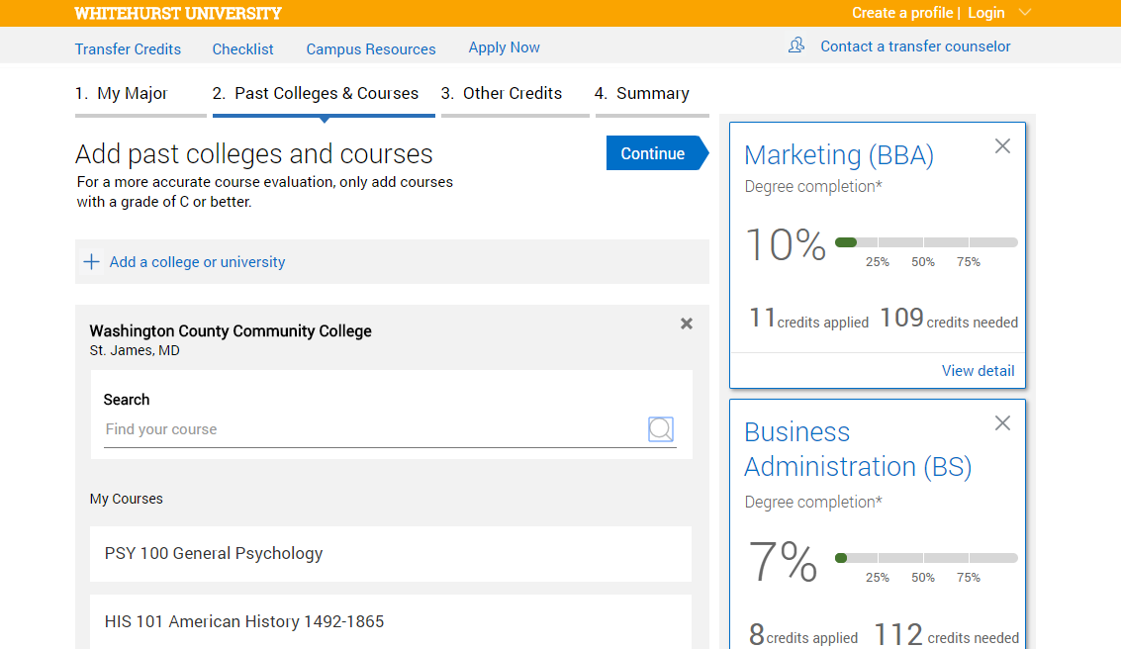



Student-facing technology to support credit estimation and exploration
Search
Application
Enrollment
Is transferring worth it?
How will my credits transfer?
What do I need to do to apply?
Major and Career Exploration
Compare majors and associated career paths, including salary and job demand
Self-Service Credit Estimation
Check how prior coursework will transfer and view progress across programs
Checklist to Enrollment
View a customized list of key events and deadlines to stay on track for application, deposit and enrollment
Access the Transfer Portal online: https://govst.transfer.degree/

Slide 27
Transfer Portal Benefits
Transfer students
Portal Helps Students Stay On Track For Transfer, Saving Time and Money
Advisors
Portal Helps 2-Year Advisors Better Support Students Seeking Transfer
Major and Career Exploration
Students compare majors and associated career paths to determine best fit
Self-service Credit Estimation
Students enter prior coursework and receive unofficial credit and progress-to-degree estimates across programs
Checklist to Enrollment
Students receive a customized checklist of key events and deadlines to stay on track to apply and enroll
Easy Access To Credit Estimates
Show students how their credit will transfer without needing to keep track of course equivalencies
Stronger Programmatic Alignment
The Transfer Portal helps ensure that course equivalencies are up-to-date, allowing us to identify and proactively close gaps
Institutional Commitment To Transfer
An admissions-facing dashboard provides visibility into transfer roadblocks and enables deeper support for transfer students

Slide 28
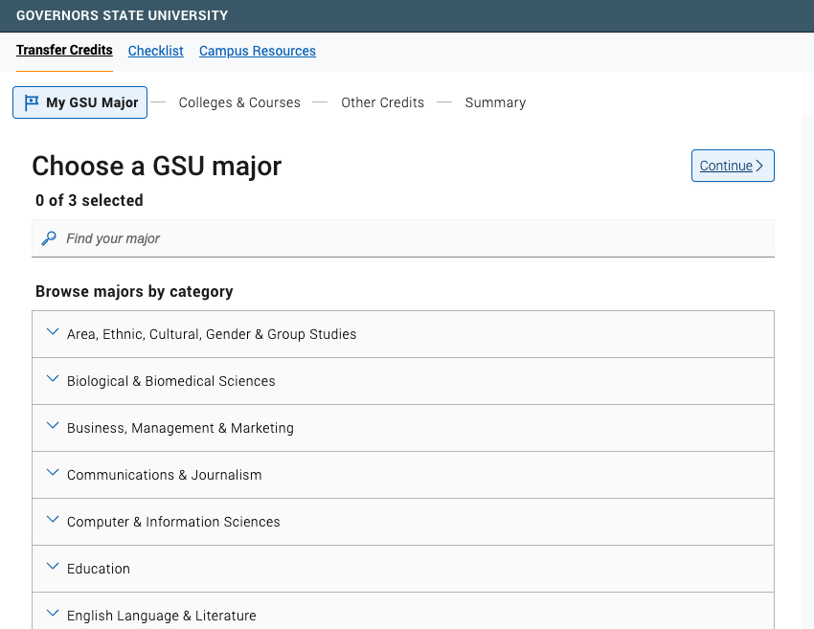

Slide 29
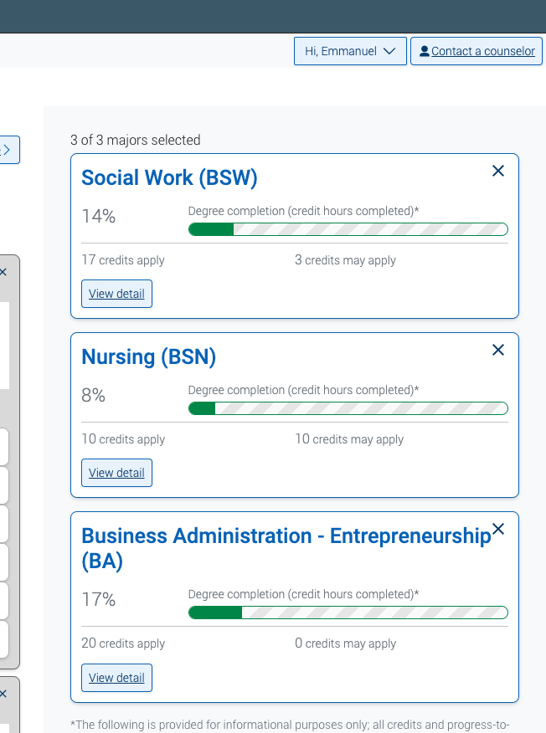

Slide 30



GOVERNORS STATE UNIVERSITY
Early Childhood Education
Incumbent Workforce
Transfer Luncheon
Spring 2023
Notes:
NOTE:
To change the image on this slide, select the picture and delete it. Then click the Pictures icon in the placeholder to insert your own image.

Slide 31

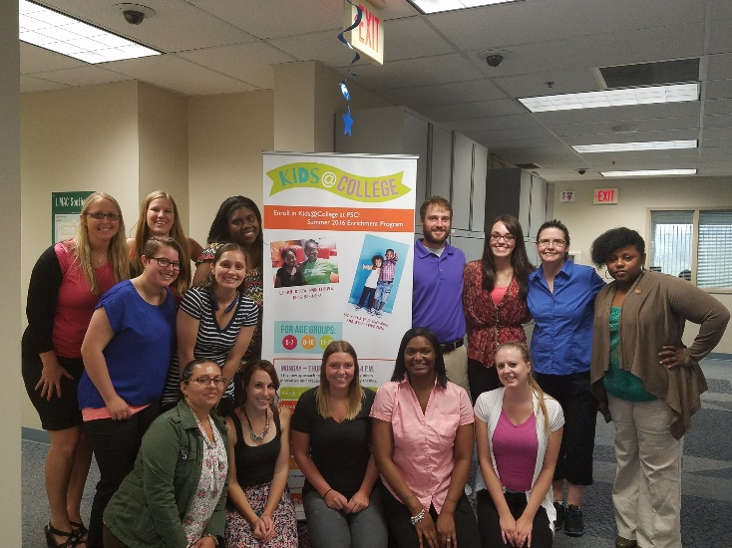
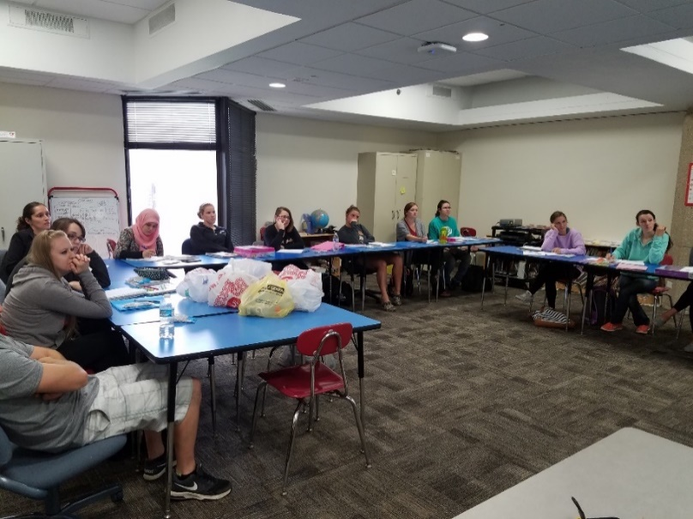
EARLY CHILDHOOD EDUCATION PROGRAM
“The Early Childhood Education Program at GSU integrates real-world, practical field experiences for our candidates leading up to a full-time student teaching residency. These placements are in diverse settings across the region, giving our candidates a rich foundation as they enter the field of education. The program also offers courses with facilitation from professional, experienced instructors. The instructors have experience as teachers and administrators in early childhood and are up to date on issues and trends.”
Dr. Katy Hisrich
ECE Program Coordinator
GSU WAS RANKED BY UNIVERSITY HQ AS ONE OF THE
BEST MOST AFFORDABLE EARLY CHILDHOOD EDUCATION PROGRAMS

Slide 32
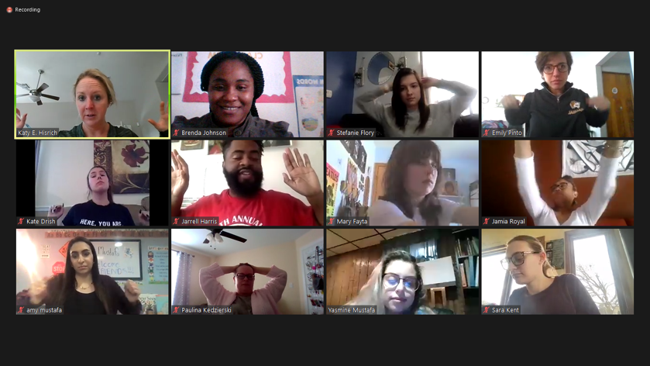
PROGRAM OVERVIEW:
BA OPTION 3, LICENSURE
INCUMBENT WORKFORCE
Candidates:
  Students who do not have a bachelor’s degree
  Students who seek initial licensure with an endorsement in Early Childhood Education (birth to grade 2)
  Students must be working in the incumbent workforce
    teacher in a childcare center or a paraprofessional in a school
Certifications earned:
  Illinois Professional Educator License (PEL)
  Early Childhood Endorsement, Birth to Grade 2
  Early Childhood Special Education Approval Endorsement
  ESL Endorsement, PreK-12
  IL Gateways Credentials
    Early Childhood (ECE), levels 1-5, Infant Toddler (ITC), levels 1-3
All students enrolled in this program must complete 121 hours of coursework:
  49-52 hours in General Education coursework
  60 hours in Professional Education coursework
  18 hours in Teacher Specialization coursework (ESL)
Class Delivery
Time: evening; Modality: online synchronous (at a scheduled class time)
Program Highlights:
  Tuition may be 100% free
  All prior college coursework from an approved associate’s degree in ECE or Child Development can
  be transferred
Option 3

Slide 33
FIELD EXPERIENCES
OVERVIEW
Field experiences are integrated into our program coursework to give students the opportunity to gain valuable training and professional connections.
These experiences include a variety of diverse settings from birth to 2nd grade. Candidates observe, engage, and teach lessons with infants/toddlers and children in preschool, kindergarten, and primary classrooms.
Candidates work with quality mentor teachers who serve as models, offer opportunities to teach and practice skills, and provide guidance and feedback.
Support is provided and scaffolded throughout the program for field experiences prior to student teaching or practicum.
*some opportunities for job-embedded field experiences

Slide 34
PRIOR LEARNING ASSESSMENT (PLA)
Interested in a degree in Early Childhood Education?
Have work experience in an Early Childhood center or school?
If yes to both, take the Prior Learning Assessment (PLA)
You can earn credit for a course in the ECE program at Governors State!
Criteria
Do you work in the early childhood education field, either as a teacher in a childcare center or a paraprofessional in a school? Or do you have experience as a teacher or a paraprofessional?
Do you have an Illinois Gateways account/membership?
Are you wanting to enroll in the Early Childhood Education program at GSU?
Are you able to complete the PLA between May-July 2023?
Are you able to attend a required short information session to learn about the next steps? This session will be held virtually in the near future (TBD).
Interested?
Contact: Jackie Snyder
jsnyder5@govst.edu
708.534.6979

Slide 35

ECACE SCHOLARSHIP
The ECACE Scholarship cover up to the total cost of attendance after other financial aid received costs. Such as tuition and fees, room and board, books and supplies.
This scholarship is GUARANTEED if you meet all requirements!
Currently, students must be a junior/senior at GSU enrolled in the Early Childhood BA program and is working or has ever worked in an early childhood setting.
In the Fall this is changing!
This program was created to address the shortage of qualified early childhood educators by encouraging the pursuit of credentials and advancement of already-held degrees in early childhood education, with an aim toward building a strong, well-prepared workforce.
ECACE is a “last financial option”. This means that all other scholarships and grants received will be used first. After that, ECACE will take place and potentially cover the rest. If you have student loans, financial aid could potentially cancel these and ECACE can cover them.
Debt Relief-ECACE can potentially cover past student debt if students are enrolled in an Early Childhood program!

Slide 36
FIRST STEPS: TRANSFER STUDENTS
Transfer Information
Transfer Credit Evaluator https://govst.transfer.degree/app/index.html#!/landing/
The Jaguar Transfer Credit Evaluator is a tool to help transfer students see how their previous college coursework and exams contribute to their degree at GSU! The process is quick, easy, and even provides next steps for transferring.
General Admission Requirements
  -24 or more semester credit hours of college coursework
  If you have earned less than 24 hours, you must apply as a freshman
  -A 2.0 or higher cumulative GPA
  -Provide official transcripts from all previously attended colleges or universities.
Apply to Governors State University as an Undergraduate
https://apply.govst.edu/apply/
Help with Transferring
Emmanuel Lopez
Elopez6@govst.edu
708.235.8528

Slide 37

IS GSU FOR YOU?
-Talk to Admissions Specialist
Find out how to become
a freshman or transfer student at GSU
(virtual or on-campus meeting)
https://apply.govst.edu/portal/virtualappointments
-Attend a GSU Open House
10:00am-1:00pm
March 25th
April 15th
https://www.govst.edu/openhouse/
-ECE Informational Sessions
Thursday, April 13th at 5:30pm
Monday, April 24th at 5:30pm
https://us02web.zoom.us/j/81154406851?pwd=TitDYWZlM0hNSmNyYjNueE9URnF2UT09
Meeting ID: 811 5440 6851
Passcode: 515434

Slide 38
Community Health
Dr. Joseph Day

Slide 39
What is Community Health?
Community health is a cross between healthcare, money matters and how people get along. It is a medical specialty that focuses on the physical and mental well-being of people. Community health is tied to both the health of individuals and how this is related to the health of the community where the individual lives.
A Bachelor's Degree in Community Health can lead to the following career paths:
Getting into medical school
Getting into dentistry
Becoming a community health worker
Working at a hospital in various roles

Slide 40
Pick the right Community Health concentration for you!
Health Promotion Across the Lifespan
Pre-Health Professionals
Foundations of Substance Abuse

Slide 41
Quality
73% rate overall experience as excellent or good.
Cost
Only around $13,000 per year for 30 credit hour.
Location
You can drive to GSU or take the Metra (University Park).
Convenience
We offer online, hybrid, in-person, evening, and afternoon classes.
Diversity
GSU is a minority serving institution, black serving institution and a emerging
hispanic serving institution.
Why
GSU?

Slide 42
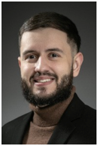
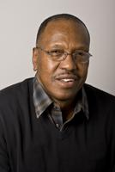
Here to help you!
Emmanuel Lopez
Assistant Director of Transfer Admissions
elopez6@govst.edu
708-263-7983
Joseph Day DrPH
Program Director | Community Health
jday2@govst.edu
708-235-7389

Slide 43

Notes:
Hello & Thank you….

Slide 44

DDP Partner Community Colleges
Notes:
Sharita

Slide 45
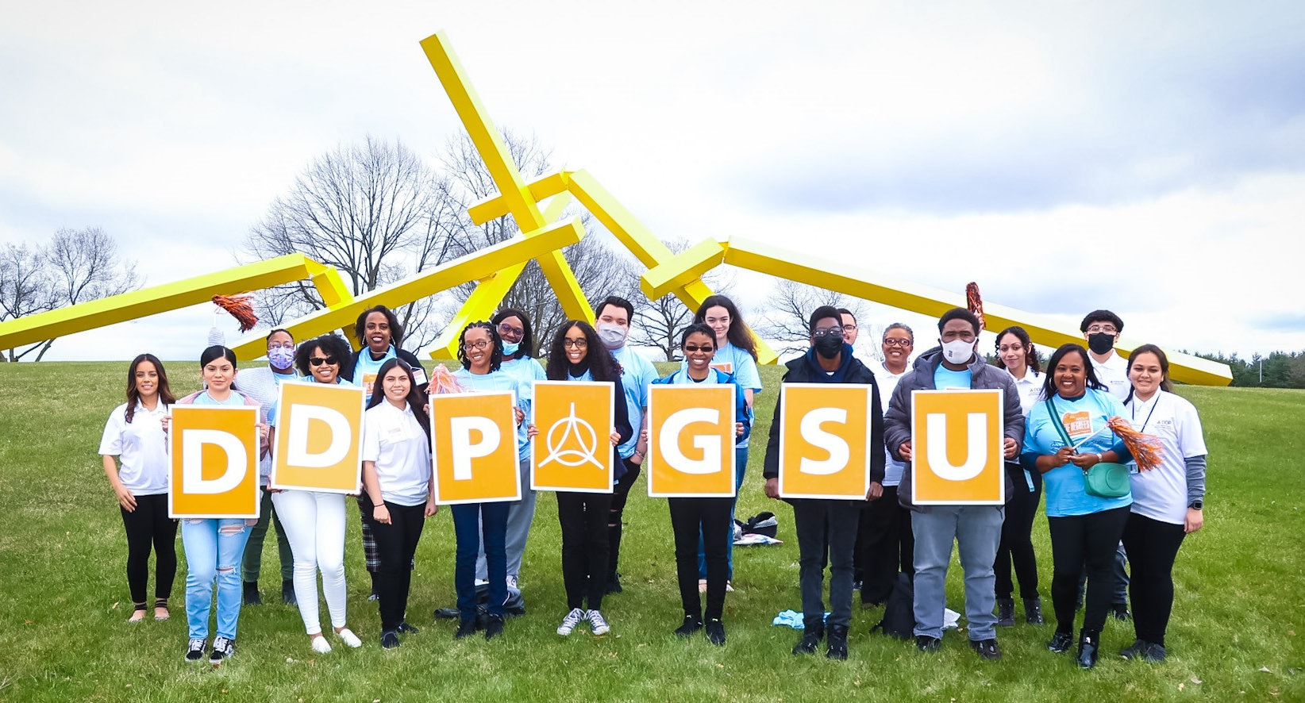
Why refer a student to DDP?
The DDP is called "dual degree" because it assists students in the completion of their associate degree and then transfer seamlessly to GSU to complete their bachelor's degree.
Students who are interested in participating in the Dual Degree Program are encouraged to join as early as possible while pursuing an associate degree at their community college.
Tuition rates are increasing for 2023-2024 – Tell students to lock in their tuition rate NOW!
Notes:
Not “dual enrollment” – we actually want them to stay and finish the degree (if not more!)
Sharita

Slide 46
Many Benefits of DDP
Personalized pre-transfer advising from DDP Transfer Specialist
Exclusive scholarship opportunities for DDP students
Locked-in GSU tuition rate at time of DDP enrollment
Guaranteed admission* to GSU and application fee waived
Exceptions with special admissions requirements include Social Work, Nursing, Business and Applied Science (BAAS) & Manufacturing Management programs
Exclusive programming, e.g., DDP Induction and Cording Ceremonies
Participate in DDP social and community service events throughout community college and GSU experiences
Access to GSU student perks prior to transferring, such as access to the Fitness Center and Center for Performing Arts student discount
* Guarantee is dependent on successful completion of the associate degree prior to transfer.
Notes:
Sharita

Slide 47
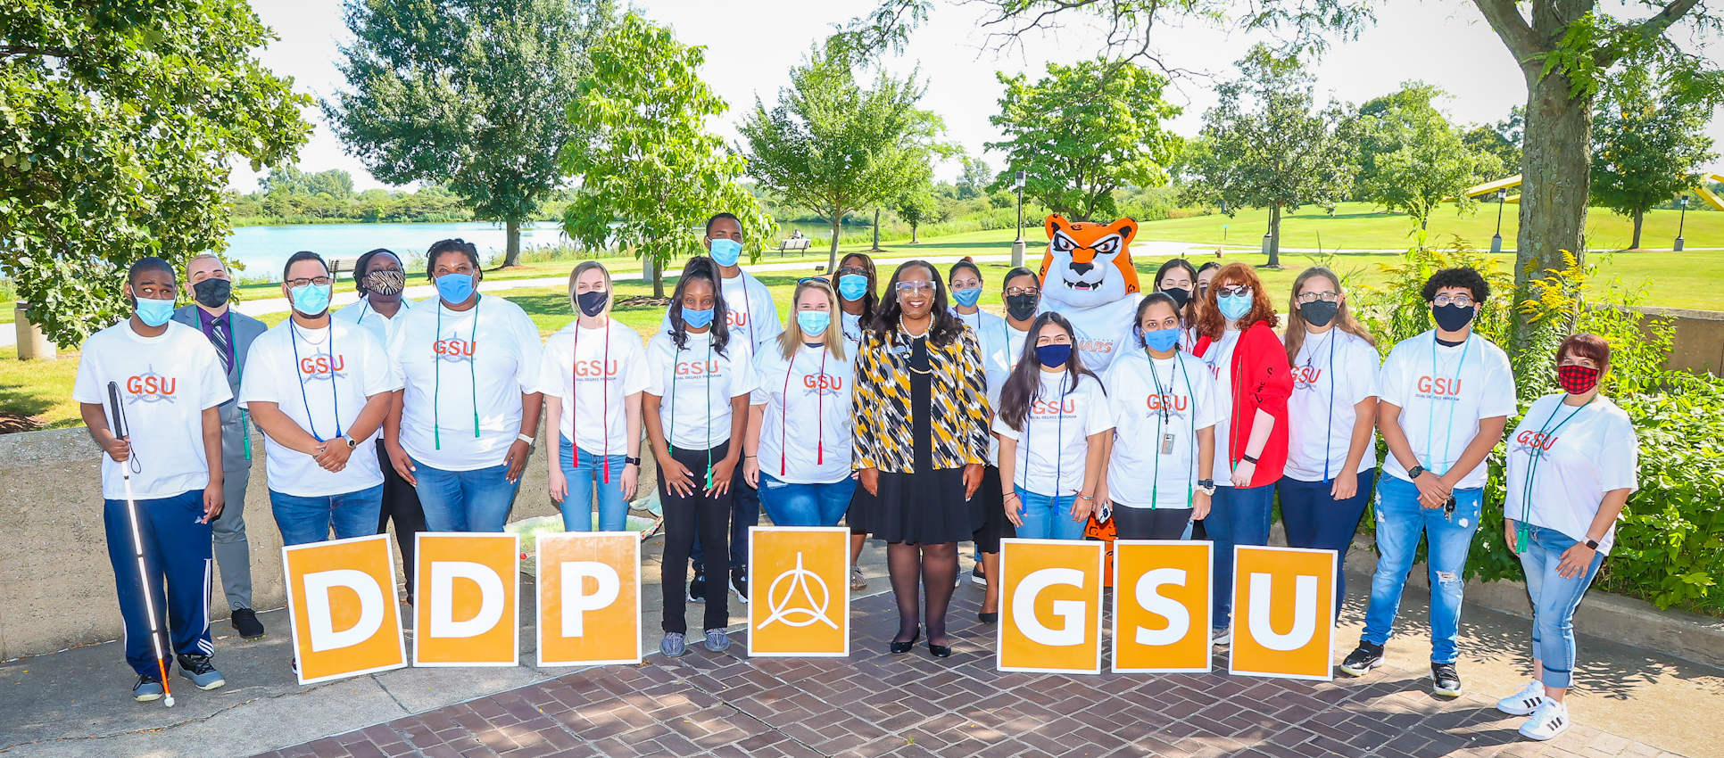
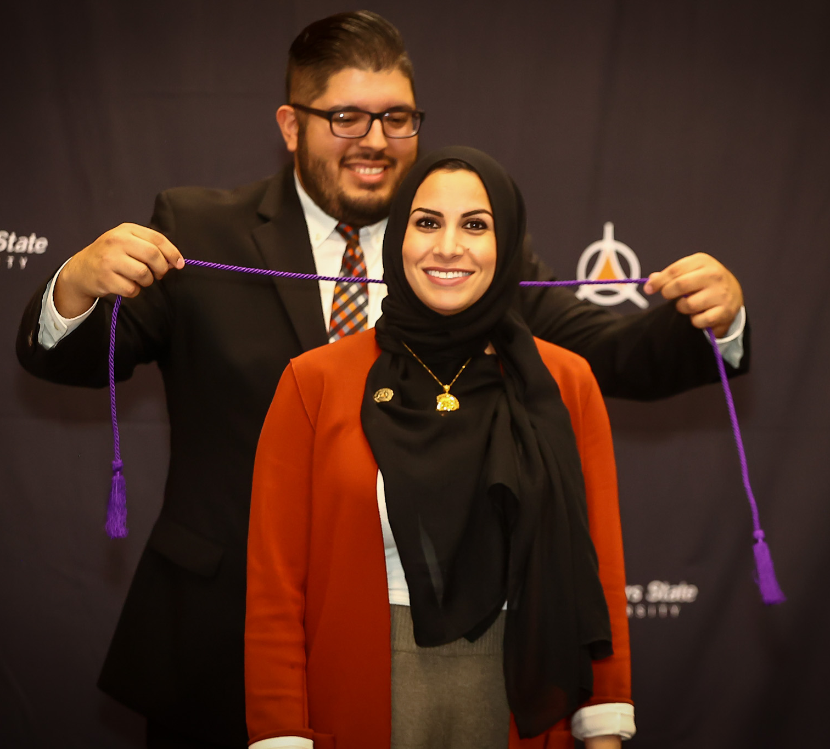
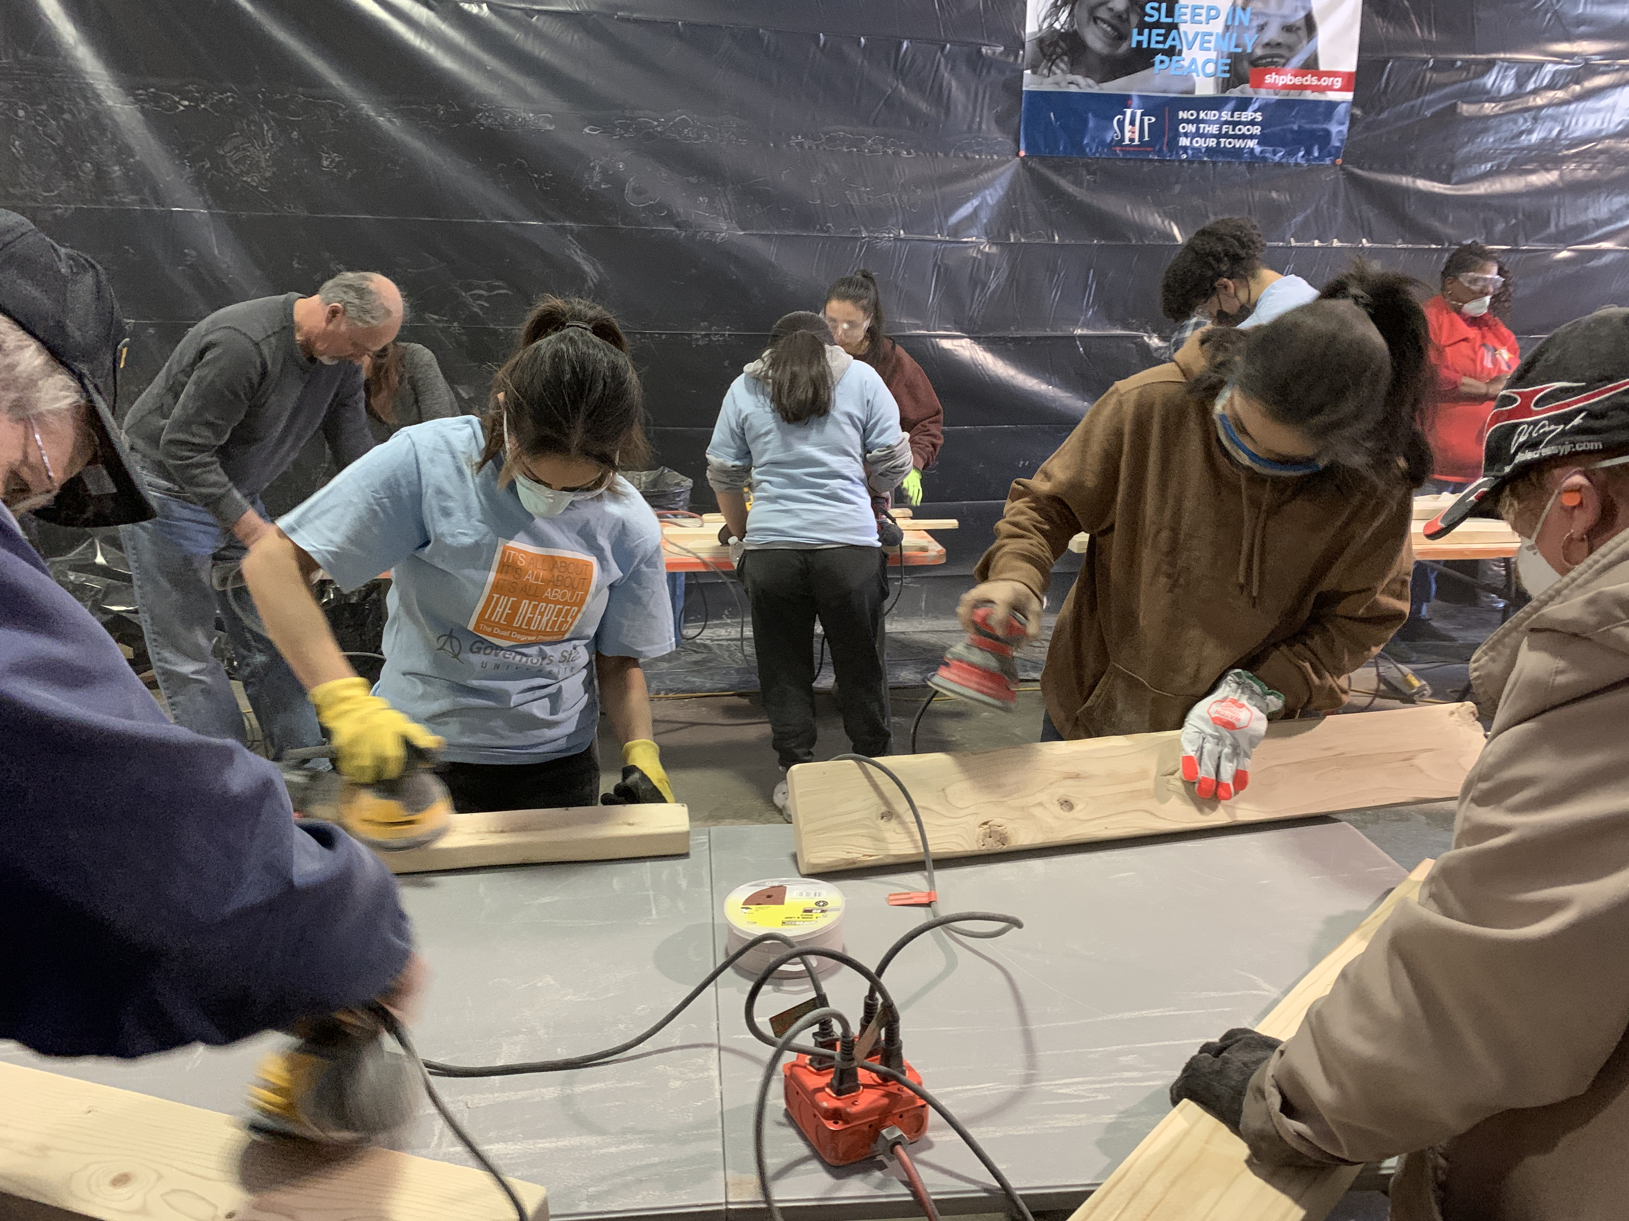

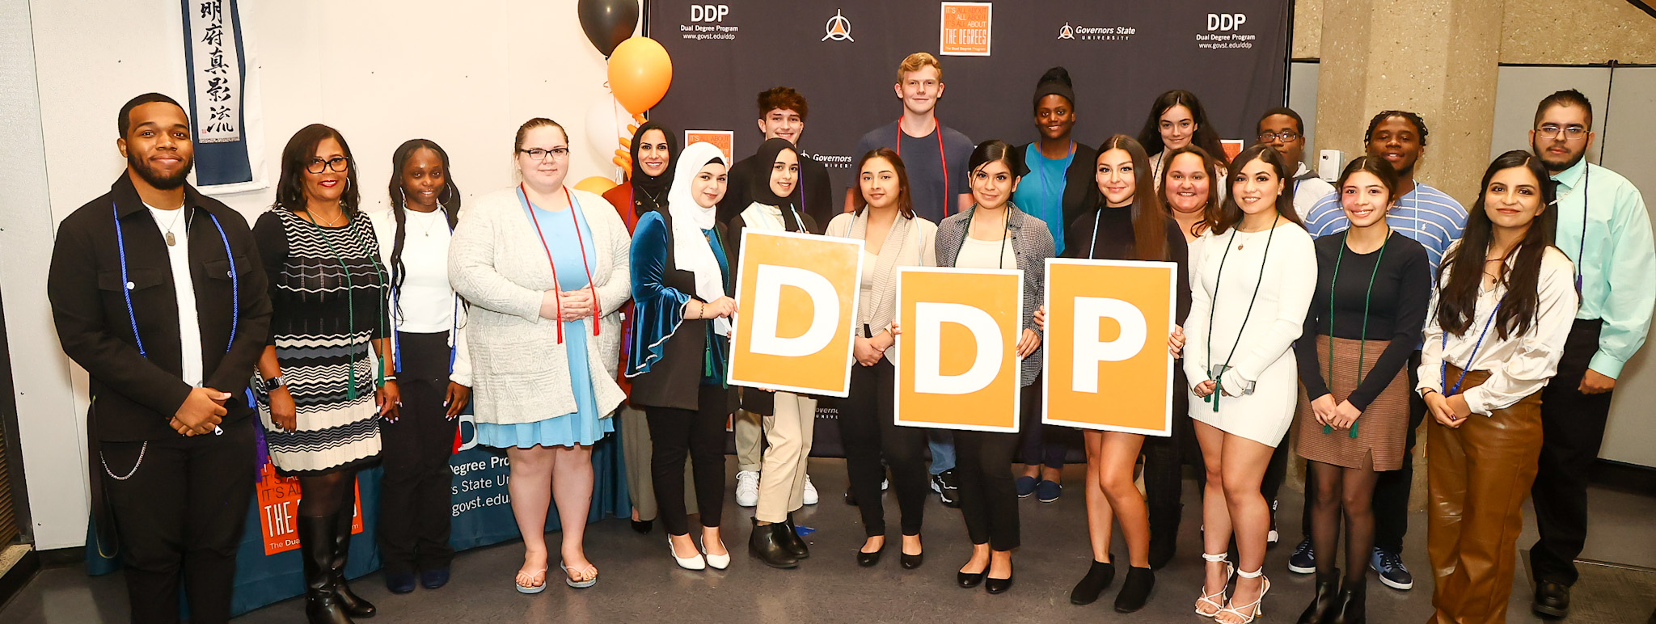
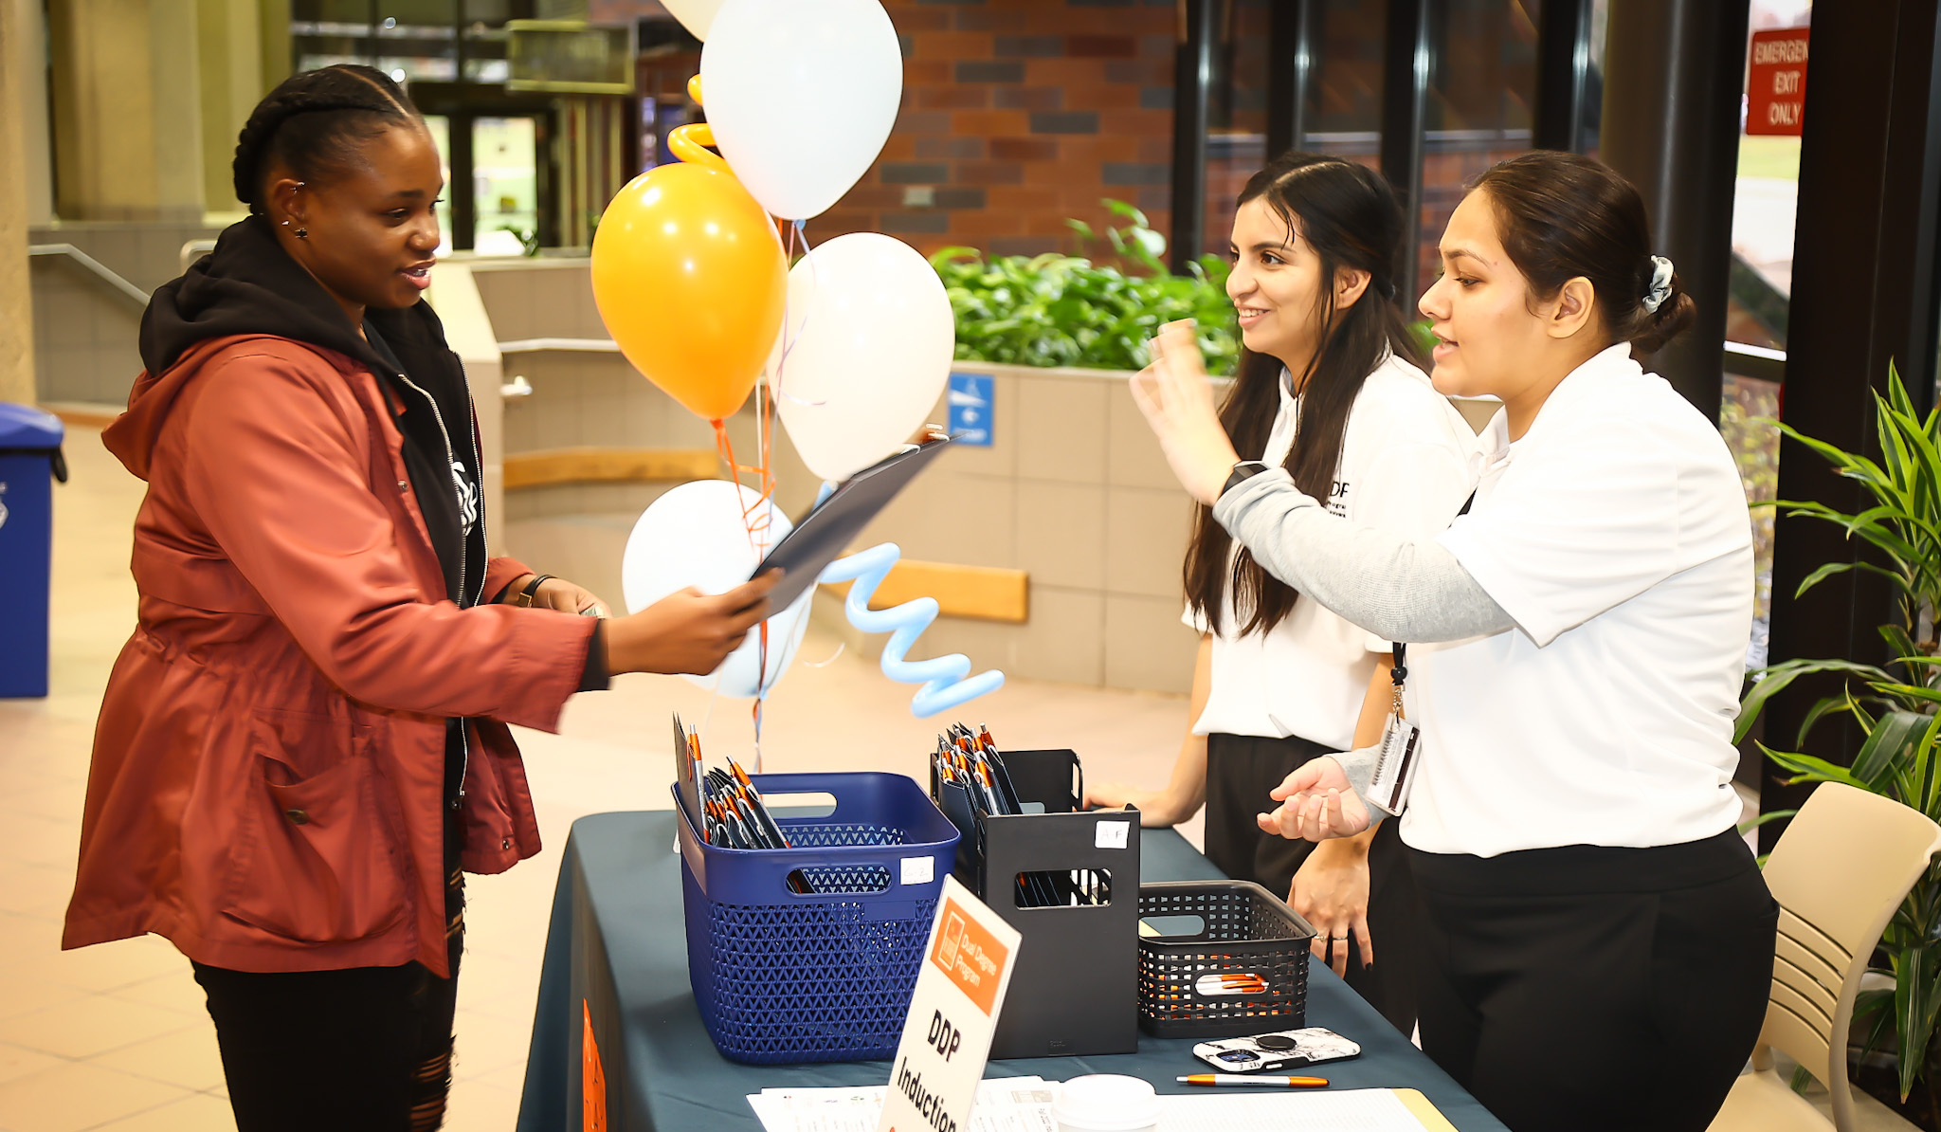
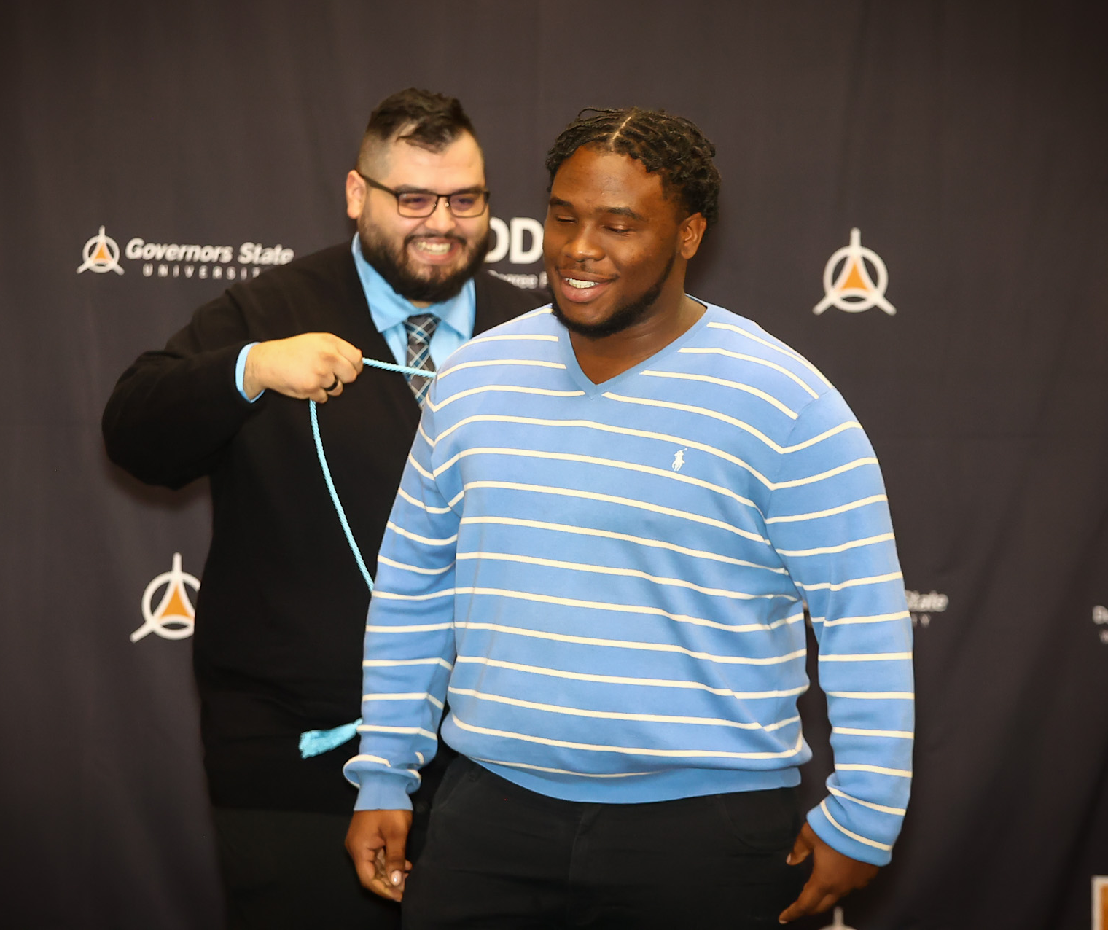
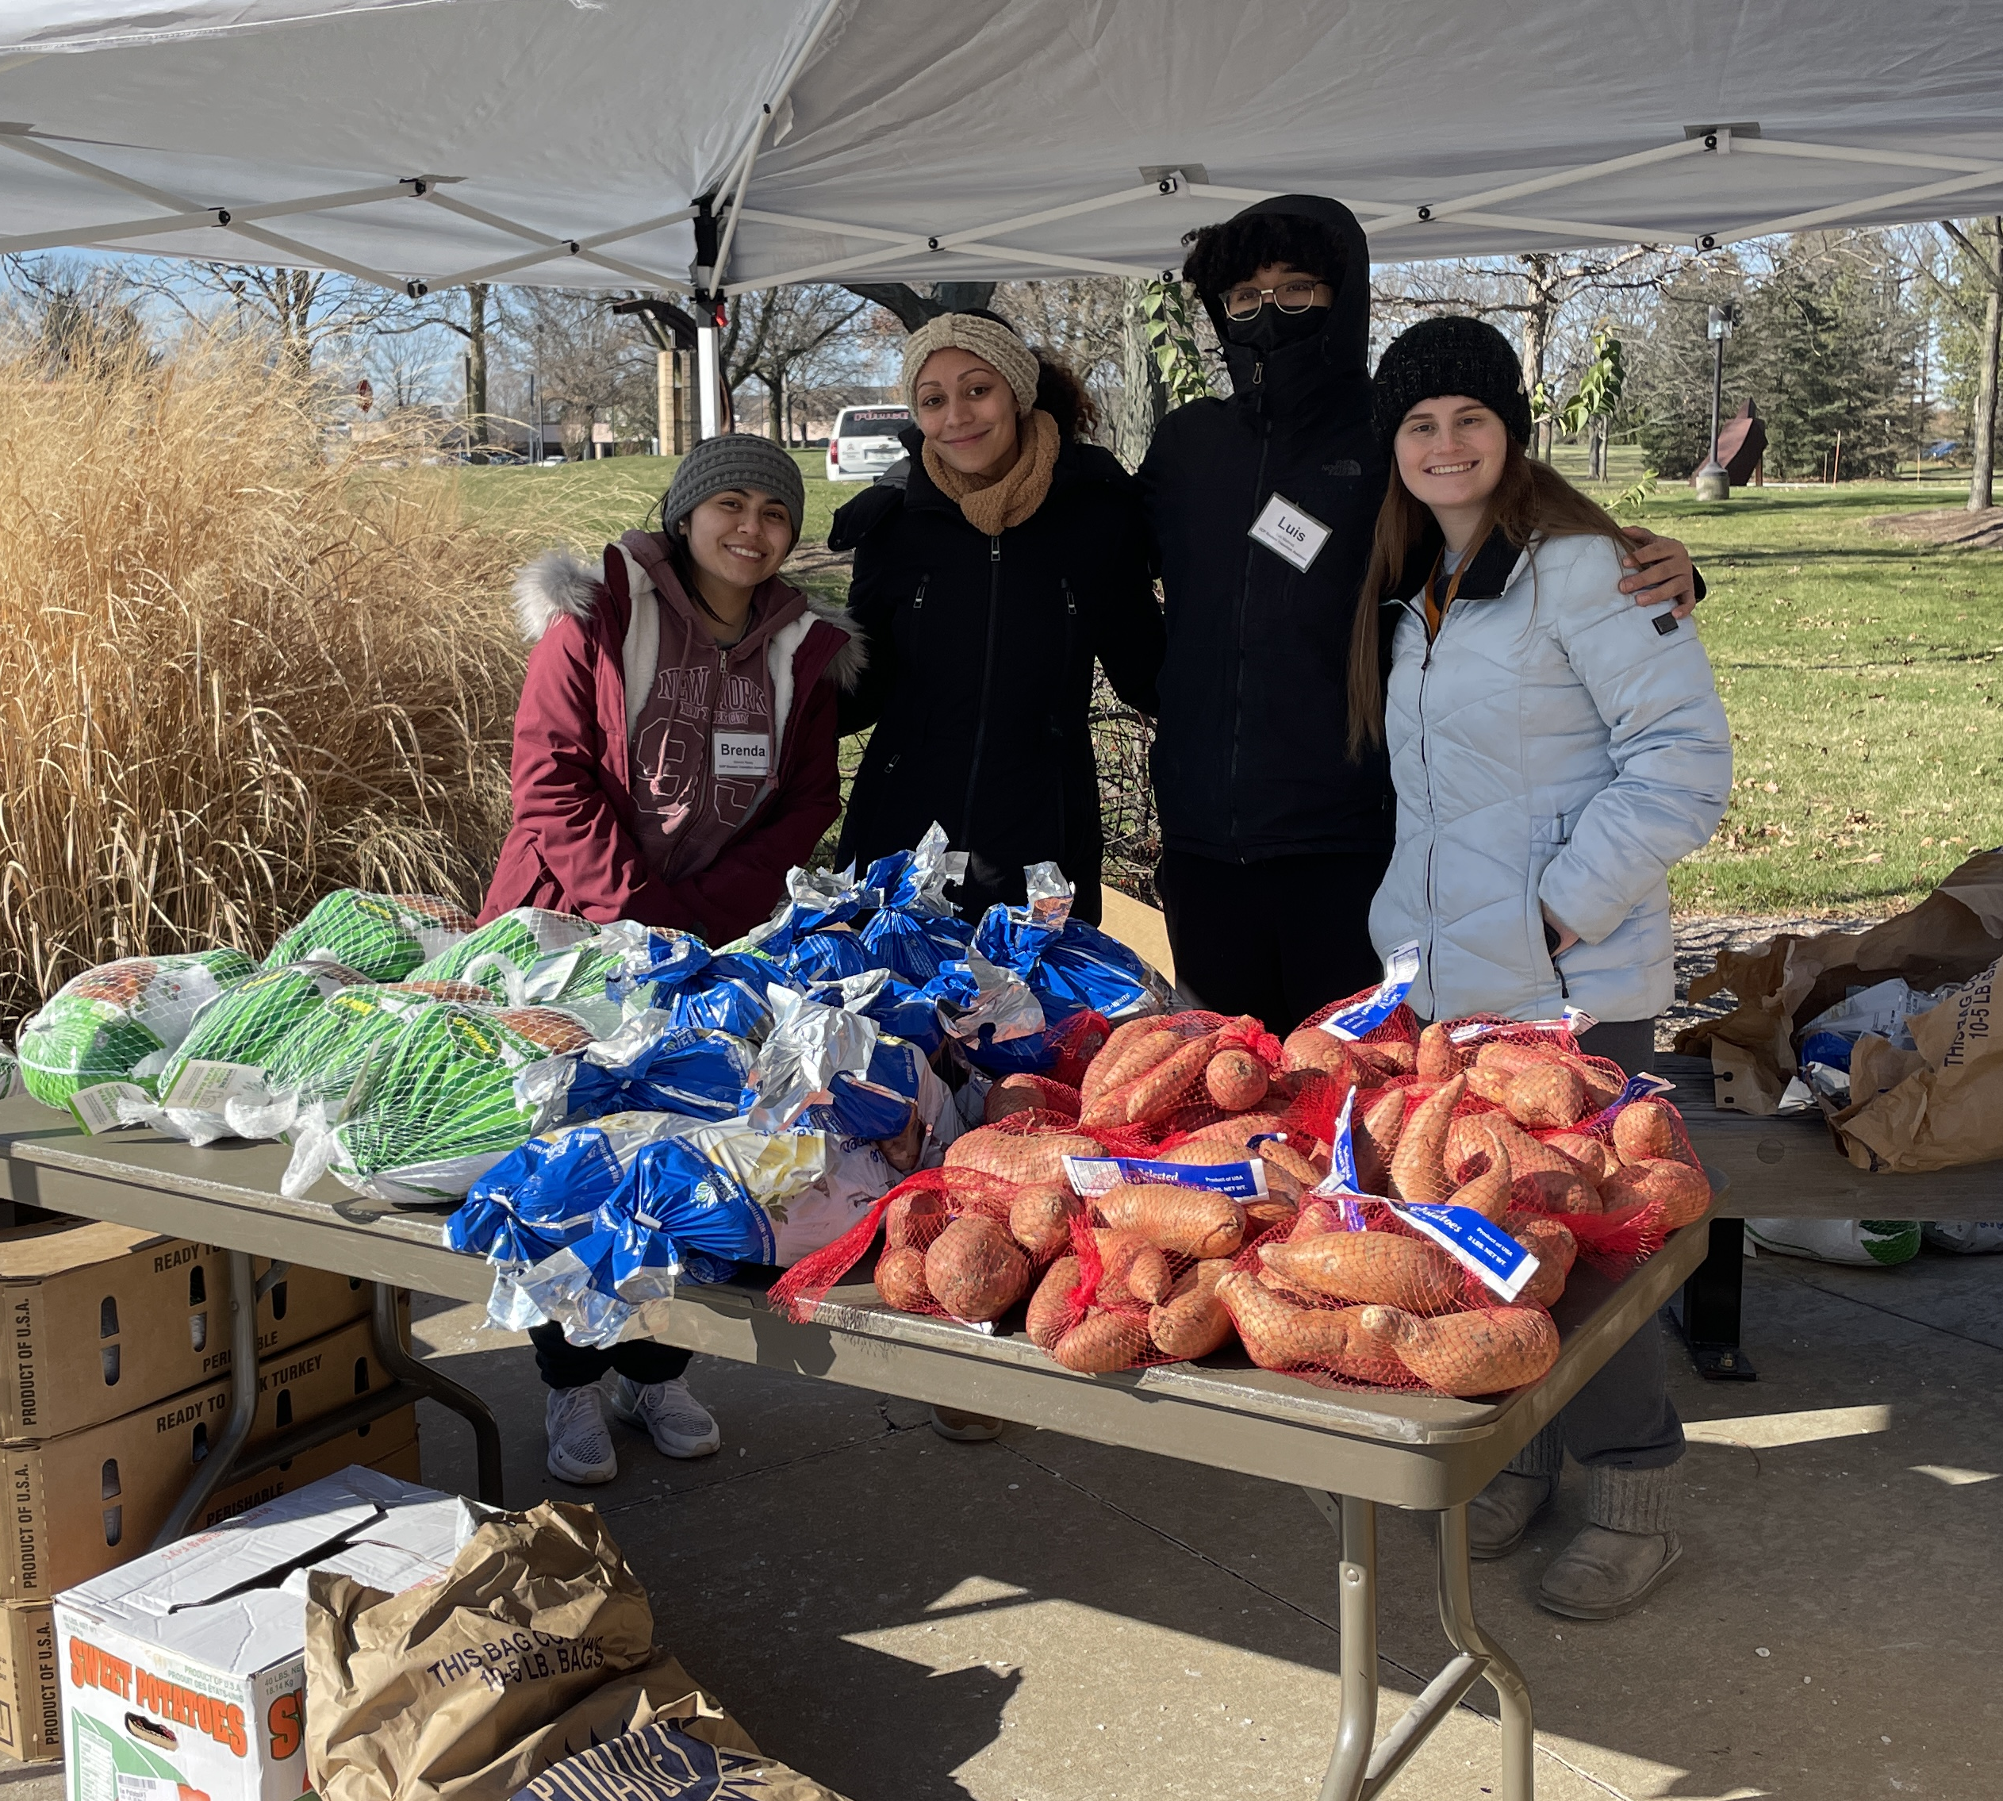
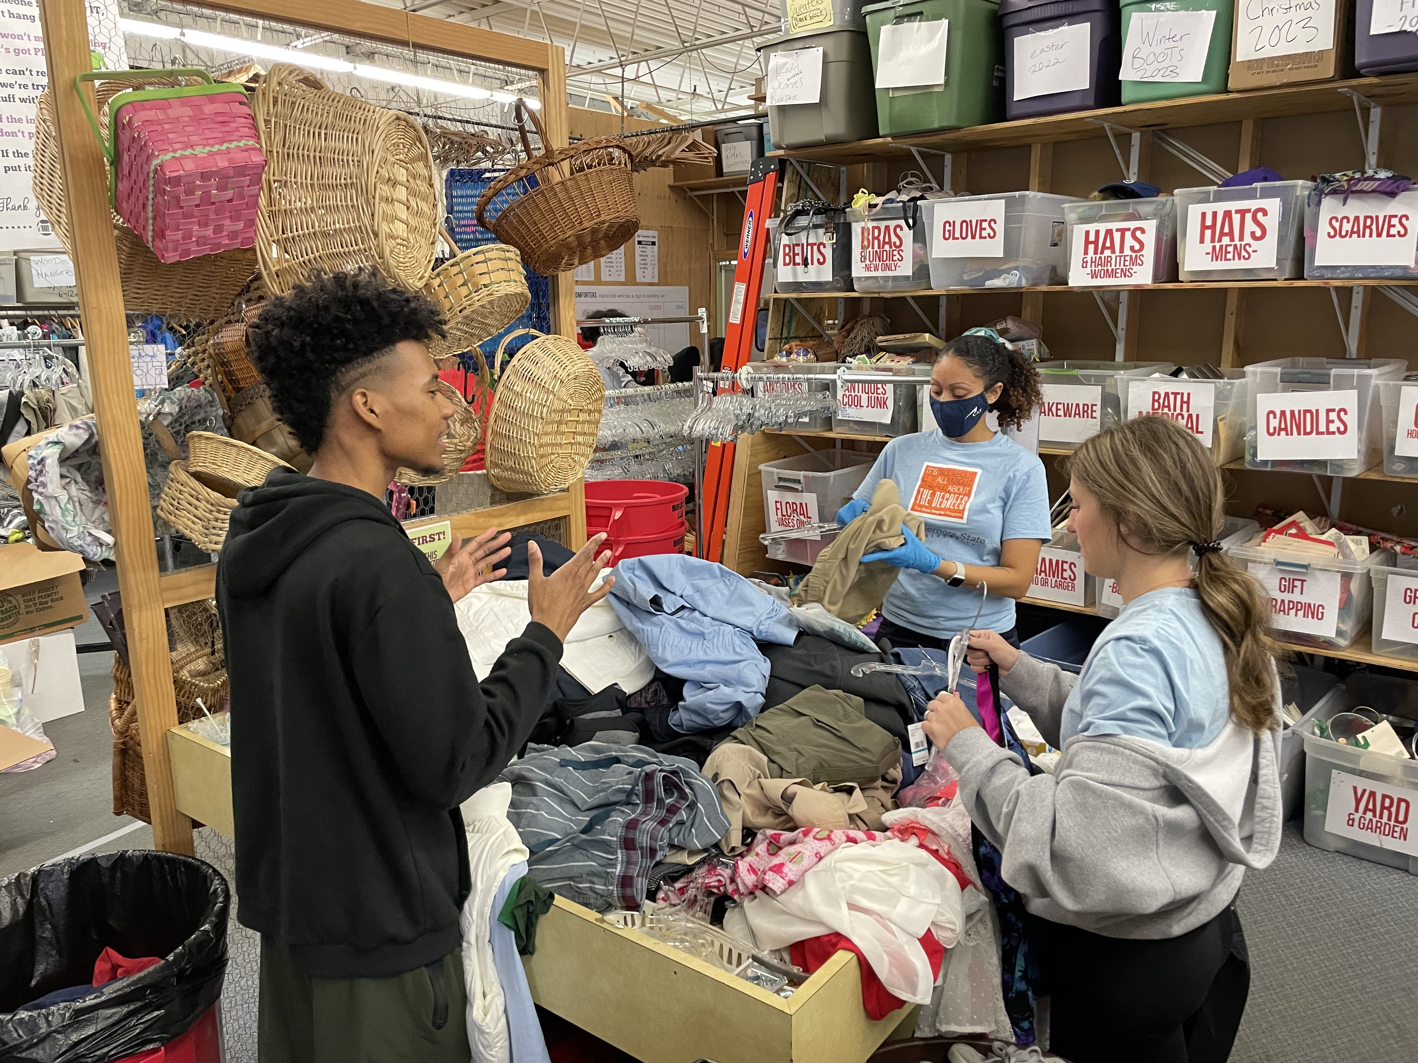
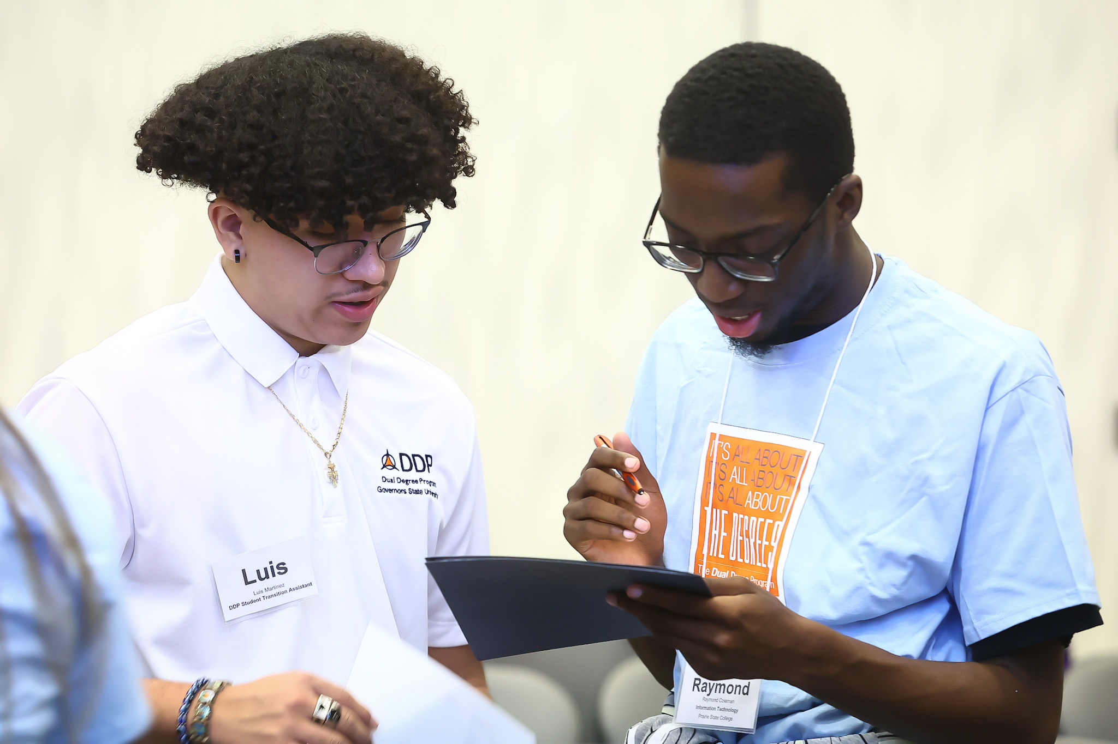
Notes:
Sharita

Slide 48
Criteria to Join DDP:
Currently enrolled at one of our 17 partner community colleges
In good academic standing (2.0+) at current community college
Intention of completing an associate degree prior to transferring
Full-time is encouraged, but not required
Why is it important for students to join DDP as early as possible?
Students want to lock in their tuition rate ASAP
Students must be in DDP prior to their final semester of community college to apply for a DDP scholarship
Students want to take advantage of pre-transfer advising to ensure they make the most of your general education and prerequisite course options
Notes:
Alex

Slide 49
Exclusive Scholarships
DDP Promise Scholarship
Requires 2.75+ GPA, associate degree, and Pell eligibility at time of transfer
Tuition & Fees assistance for up to four semesters (fall/spring)
DDP Honors Scholarship
Requires 3.5+ GPA, associate degree, and membership in Phi Theta Kappa or CC Honors
Commitment to participating in the GSU Honors Program
Tuition & Fees assistance for up to four semesters (fall/spring)
DDP Chicago STAR Scholars Scholarship
Requires a 3.50+ GPA, and must be a current participant in the Chicago STAR Scholars program at the City Colleges of Chicago
Option #1 (spring & fall): $500 book/campus dining award for up to four semesters
Option #2 (fall starts only): Campus housing contract (semi-suite) for up to two years
Undocumented students who are eligible for in-state tuition are encouraged to apply!
Note: Undocumented students receiving the DDP Promise are also required to complete the ISAC Alternative Application for Financial Aid.
Notes:
ALex

Slide 50
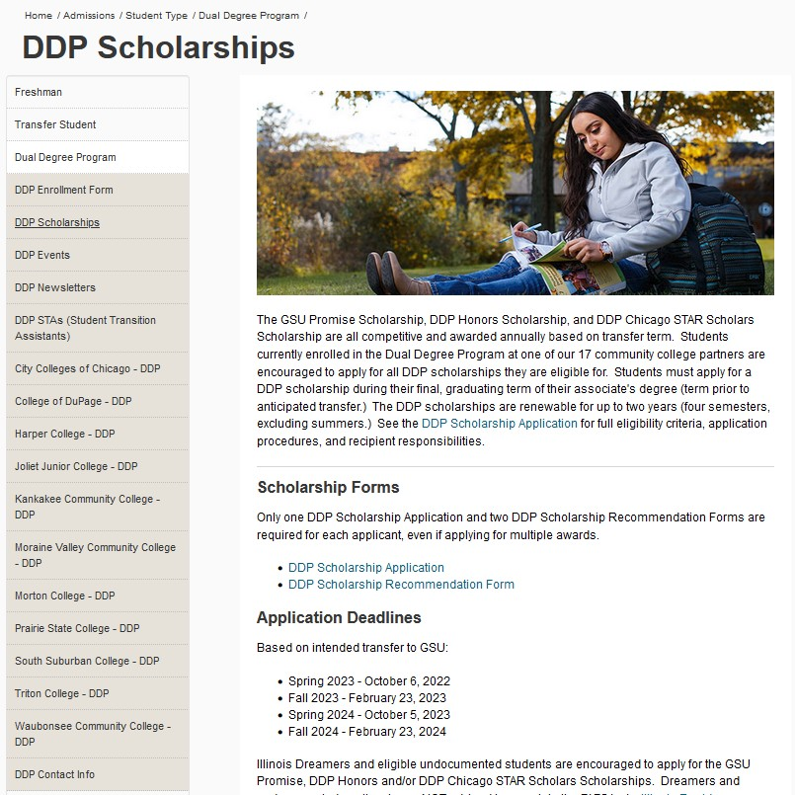
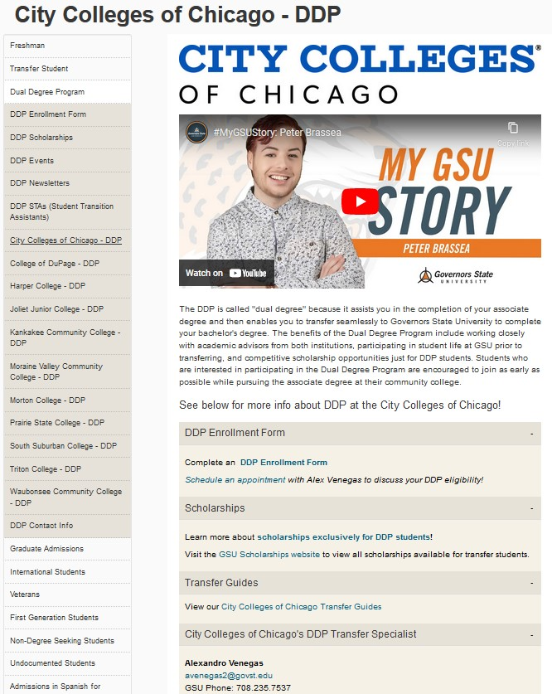
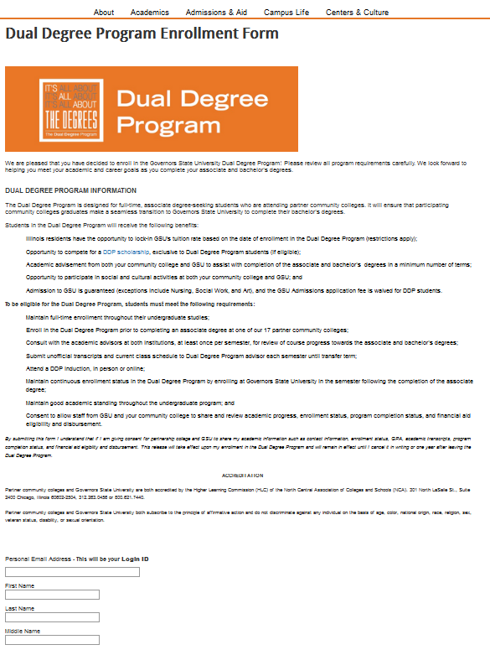
All DDP forms are now digital on the website!
Notes:
Alex

Slide 51
DDP Student Success
Over 1,080 DDP students completed their associate degrees and enrolled at GSU.
Over 87% of the students that completed their associate degrees and transferred to GSU have graduated or are enrolled and on-track for their bachelor’s degree
Average GPA of a DDP student at graduation is 3.60
63% of DDP students at GSU graduate in four semesters or less
Awarded over $120,000 in DDP Scholarships this academic year
Of the 254 DDP students in the pipeline at our partner community colleges, over 63% of those students are first-generation, over 65% identify as belonging to at least one racial and/or ethnic minority, and 35% are over the age of 25.
Notes:
Juan

Slide 52
DDP Success Metrics (cont.)
 | All GSU Transfers | DDP Transfers | Difference
Fall to Fall Retention (entry in Fall ‘21) | 63% | 85% | 22%
Fall to Spring Persistence (entry Fall ’19-Fall ‘22) | 77% | 90% | 13%
Time to Degree (AY 21-22 Grads) | 2.6 Years | 2.3 Years | 1 Less Semester
Office of Institutional Research, GSU (2023)
Notes:
Juan

Slide 53
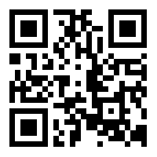
Juan Gonzalez
Joliet Junior College, Moraine Valley, Morton College, Triton College, Harper College, COD, and Waubonsee Community College
jgonzalez11@govst.edu ꟾ 708.235.7534 ꟾ GSU Office: A2122
Alexandro Venegas
City Colleges of Chicago (all seven campuses)
avenegas2@govst.edu ꟾ 708.235.7537 ꟾ GSU Office: A2122
Sharita Walker
Kankakee Community College, Prairie State College, and South Suburban College
swalker3@govst.edu ꟾ 708.235.7536 ꟾ GSU Office: A2122
Jessica Specht
Director of the Dual Degree Program
jspecht@govst.edu ꟾ 708.534.4494 ꟾ GSU Office: A2128
www.govst.edu/ddp
Notes:
Juan

Slide 54
GSU DDP Student Panel

Slide 55
“Supporting Students Towards Academic & Personal Success”
“Supporting Students Towards Academic & Personal Success”
Prepared By:
Lester Moody, Retention Coach
Abrea Ramadan, ARC Graduate Assistant
Kara Lester, Retention Coordinator
Prepared By:
Lester Moody, Retention Coach
Abrea Ramadan, ARC Graduate Assistant
Kara Lester, Retention Coordinator

Slide 56
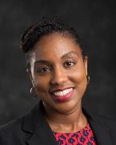
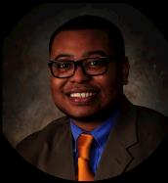
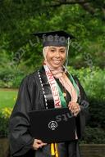
Retention Overview
Retention Overview
Students experiencing challenges in pursuit of their degree can connect with ARC Retention support staff to obtain the tools needed to succeed. ARC retention support staff assist students in creating a plan that allows them to address any obstacles impeding on their academic and personal success. ARC retention support staff are equipped to administer ser­vices focused on time management, effective study skills, academic coaching and more. ARC retention support staff are also knowledgeable of campus resources and can refer stu­dents to the appropriate resources when necessary, as well.
Students experiencing challenges in pursuit of their degree can connect with ARC Retention support staff to obtain the tools needed to succeed. ARC retention support staff assist students in creating a plan that allows them to address any obstacles impeding on their academic and personal success. ARC retention support staff are equipped to administer ser­vices focused on time management, effective study skills, academic coaching and more. ARC retention support staff are also knowledgeable of campus resources and can refer stu­dents to the appropriate resources when necessary, as well.
Kara Lester
Retention Coordinator
Kara Lester
Retention Coordinator
Lester Moody, Retention Coach
Abrea Ramadan, ARC Graduate Assistant
Lester Moody, Retention Coach
Abrea Ramadan, ARC Graduate Assistant

Slide 57
Why Academic Standing at GSU Matters?
The goal for all students at GSU, Good Academic Standing
  Cumulative(CUM) GPA: Minimum 2.0, Undergraduate
Failing to meet the minimum CUM GPA required, results in either of the following:
  Academic Probation
    CUM GPA Earned: 1.0-1.9
  Academic Probation Extended
    CUM GPA Earned: 0.0-.9
  Academic Suspension
    Occurs the term when student on Academic Probation Extended, does not obtain at least a 2.0. Petition required for any chances of being readmitted

Slide 58
Graduate Student
The goal for all students at GSU, Good Academic Standing
  Cumulative(CUM) GPA: Minimum 3.0, Graduate
Failing to meet the minimum CUM GPA required, results in either of the following:
  Academic Probation
    CUM GPA Earned: 2.0-2.9
  Academic Probation Extended
    CUM GPA Earned: 0.0-1.9
  Academic Suspension
    Occurs the term when student on Academic Probation Extended, does not obtain at least a 3.0. Petition required for any chances of being readmitted

Slide 59
“Our Approach”
The goal is to guide students towards taking initiative in shaping decisions impacting their academic progress and success at GSU
  Outreach
  Academic Coaching
  Learning Agreements/GSU STAR
  Programming/Course: Pathways to Academic Recovery, Save My Semester, Back on Track

Slide 60
Academic Coaching
Given our similar nature, we are commonly thought of as being academic advisors; however, we differ in that we do not do degree planning
Instead, we aim to understand the circumstances impacting the student, but most importantly what is their desired goal(s)
We begin with what’s already working & support the student in either fine tuning or establishing a plan to address in barriers impacting their education
During the final session, we assess student progress with a focus on highlighting success, while continuing to provide support towards items still being addressed

Slide 61
Early Alert System
“GSU STAR”
Used by staff & faculty to track and monitor student progress
  For example, if a student is flagged for “low test or quiz scores”, students will be “Referred” to Tutoring. This office will complete outreach and attempt to schedule an appointment with student
Alternatively, “Kudos” are raised when students are demonstrating progress and/or success
Students can also utilize the “Raise Hand” feature and a member of their success network will follow up to provide support

Slide 62
Program Updates
Lisa Helm
Director of Transfer and Persistence Initiatives

Slide 63

GSU Updates
The following is information about changes happening at GSU for the 2023-2024 Academic Year

Slide 64

2023-2024 General Updates
Residency is now 30 hours. Previously, it was 24 hours.
UG Tuition will be $328 a credit hour starting Fall 2023.
Fee information is in the catalog, several fees are changing from per credit hours to full-time or part-time status.

Slide 65

College of Arts and Sciences
Anthropology – Sociology is now approved as an online program.
Criminal Justice has changed the core and has been approved as an online program.
Interdisciplinary Studies now requires 15 hours of IDSS courses.

Slide 66

College of Business
Accounting Students preparing for professional certifications should choose electives as follows:
• Certified Internal Auditor (C.I.A.) Examination - ACCT-4355 is recommended.
• Certified Management Accountant (C.M.A.) Examination - ACCT-4112, ECON-3404, and MGMT-3400 are recommended.
• Certified Public Accountant (C.P.A.) Examination - ACCT-4154, ACCT-4252, and ACCT-4355 are recommended.

Slide 67

College of Health and Human Services
Communication Disorders will be making changes to the requirements due to the change in certification requirements. They will no longer require Intro to Education and Educational Psychology.

Slide 68
Transfer Guides
We will be updating transfer guides on the website to be mobile device friendly and will be including additional information related to the programs and completion.
body

Slide 69
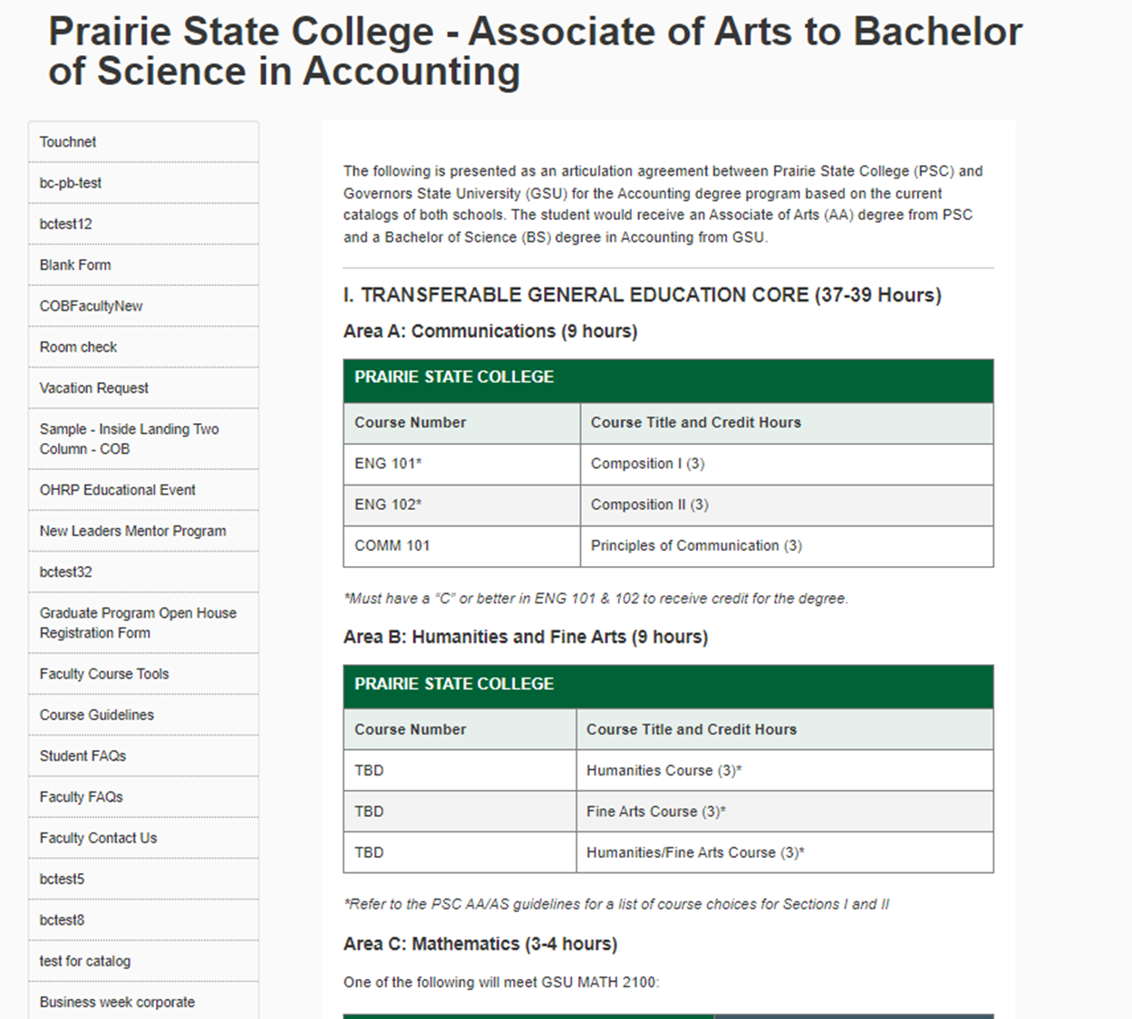

Slide 70
GSU Star
GSU STAR students create their own individual success networks consisting of the student, his/her course instructors, advisor, and support staff. Everyone in the network works together with one common goal in mind - achieving student success. Students receive instructor feedback on class performance, can schedule appointments, and raise a flag if they have a question or concern. The network allows advisors to centralize communication and take a more holistic approach to student success. In addition, faculty can send referrals, messages, feedback, or kudos to students.
We do both proactive and positive outreach

Slide 71

Questions?

Slide 72


Thank You!
body

